Slide 1




Java Basics
Java Syntax, Conditions, Loops, Methods, Objects, Collections
Java
Basics
SoftUni Team
Technical Trainers
Software University
http://softuni.bg

Slide 2


Table of Contents
Welcome to Java
Variables and Operators
Conditions: if-else, switch
Loops: for, while, do-while, …
Methods, parameters, return value
Objects and Classes
Arrays and Collections: ArrayList, Map, Set
Lambda Expressions and Stream API

Slide 3
Have a Question?
sli.do #3295

Slide 4

Welcome to Java
Java is a statically-typed, object-oriented programming language
Very similar to C#, but less flexible
Programs are compiled before execution
Variables' types cannot be changed
In contract, JavaScript and PHP are dynamically-typed (scripting) languages
Can work in interactive mode (REPL)
No compilation, just execute commands

Slide 5
Hello World in Java
HelloJava class always stays in a file named HelloJava.java
HelloJava.java
The { stays at the same line
public class HelloJava {
public static void main(String[] args) {
System.out.println("Hello Java!");
}
}
Program entry point: main() method

Slide 6
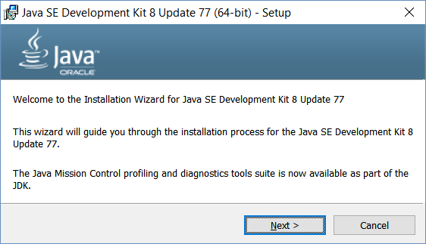
Installing Java
Download and install Java 8 SDK (JDK 8)
http://oracle.com/technetwork/java/javase/downloads/
Provides runtime environment (JRE) + compilers + tools
JRE (Java Runtime Environment)
https://java.com/en/download/
JRE is for end-users, not for devs
Developers should use JDK

Slide 7
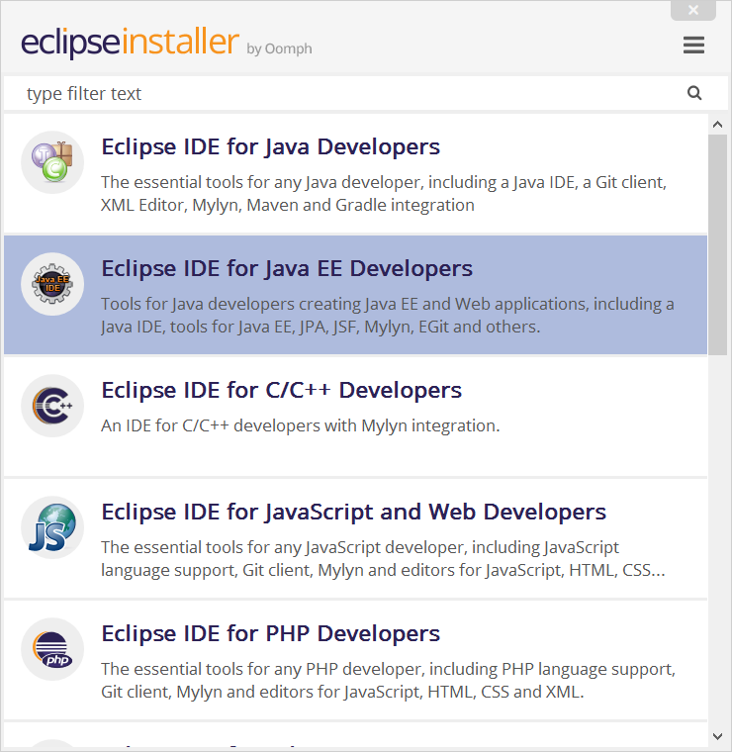

Eclipse for Java EE
Eclipse is open-source Java / Java EE / PHP / C++ IDE
Install Eclipse for Java EE

Slide 8
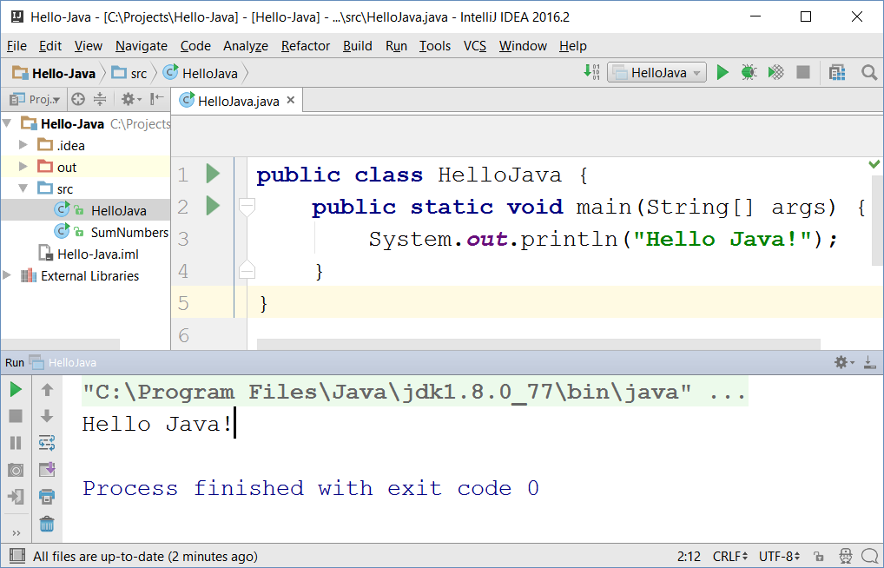

IntelliJ IDEA
JetBrains IntelliJ IDEA
Powerful Java IDE
Community edition (free)
Ultimate edition (commercial)

Slide 9
Variables and Operators in Java
Play with Java online:
www.javarepl.com
Define variables by their type
int i = 5; double d = 3; // i is integer, d is double
System.out.println(i + " ; " + d); // 5 ; 3.0
d = i * d; d++; // d = 16.0
System.out.println(d + 1); // 17.0
The ; separates multiple statements
String str = "Hello";
str = str + " Java";
System.out.printf("str = %s", str); // str = Hello Java
The %s is a string placeholder
System.out.print(s); // Compilation error: unknown symbol s

Slide 10
Problem: Calculate Expression
Write a Java program to calculate and print the value of the following expression: [(30 + 21) * 1/2 * (35 - 12 - 1/2)]²
Sample solution:
double val = (30 + 21) * 1/2.0 * (35 - 12 - 1/2.0);
double valSquare = val * val;
System.out.println(valSquare);
Check your solution here: https://judge.softuni.bg/Contests/Practice/Index/264#0

Slide 11
Problem: Sum Two Numbers
Write a Java program to sum two real numbers:
import java.util.Scanner;
public class SumTwoNumbers {
public static void main(String[] args) {
Scanner scan = new Scanner(System.in);
double num1 = scan.nextDouble();
double num2 = scan.nextDouble();
System.out.printf("Sum = %.2f", num1 + num2);
}
}
Check your solution here: https://judge.softuni.bg/Contests/Practice/Index/264#1

Slide 12
Conditions: if-else Statement
Java implements the classical if / if-else statements:
int number = 5;
if (number % 2 == 0) {
System.out.println("Even number");
}
else {
System.out.println("Odd number");
}

Slide 13
Beware of Comparing Strings
String s = "sho"; if ("Pesho" == "Pe" + s) { System.out.println("Здрасти, Пешо!"); }

Slide 14
Problem: Three Integers Sum
You are given 3 integers
Check whether the sum of two of them is equal to the third
Print the output in format a + b = c (where a ≤ b)
8 15 7
7 + 8 = 15
3 8 12
No
-5 -3 -2
-3 + -2 = -5
0 0 0
0 + 0 = 0
Check your solution here: https://judge.softuni.bg/Contests/Practice/Index/264#2

Slide 15
Solution: Three Integers Sum
public static void main(String[] args) {
Scanner scan = new Scanner(System.in);
int num1 = scan.nextInt();
int num2 = scan.nextInt();
int num3 = scan.nextInt();
if (!checkThreeIntegers(num1, num2, num3) &&
!checkThreeIntegers(num3, num1, num2) &&
!checkThreeIntegers(num2, num3, num1))
System.out.println("No");
}
Check your solution here: https://judge.softuni.bg/Contests/Practice/Index/264#2

Slide 16
Solution: Three Integers Sum (2)
static boolean checkThreeIntegers(
int num1, int num2, int sum) {
if (num1 + num2 != sum)
return false;
if (num1 <= num2)
System.out.printf("%d + %d = %d\n", num1, num2, sum);
else
System.out.printf("%d + %d = %d\n", num2, num1, sum);
return true;
}
Check your solution here: https://judge.softuni.bg/Contests/Practice/Index/264#2

Slide 17
The switch-case Statement
Selects for execution a statement from a list depending on the value of the switch expression
int day = 3;
switch (day) {
case 1: System.out.println("Monday"); break;
case 2: System.out.println("Tuesday"); break;
case 3: System.out.println("Wednesday"); break;
…
case 7: System.out.println("Sunday"); break;
default: System.out.println("Error!"); break;
}

Slide 18
Loops: for, while, do-while, …
The for / while / do-while loops work as in C++, C# and Java
for (int i = 0; i <= 10; i++)
System.out.println(i); // 0 1 2 3 4 … 10
int count = 1;
while (count < 1024)
System.out.println(count *= 2); // 2 4 8 … 1024
String s = "ha";
do { System.out.println(s); s = s + s; }
while (s.length() < 10); // ha haha hahahaha

Slide 19
Problem: Sum N Integers in Java
import java.util.Scanner;
public class SumIntegers {
public static void main(String[] args) {
Scanner scan = new Scanner(System.in);
int n = scan.nextInt();
long sum = 0;
for (int i = 0; i < n; i++)
sum += scan.nextInt();
System.out.println("Sum = " + sum);
}
}
5
10
20
30
40
-1
99
Check your solution here: https://judge.softuni.bg/Contests/Practice/Index/264#3

Slide 20
Problem: Symmetric Numbers
Write a Java program that finds and prints all symmetric numbers in the range [1…n]
1 2 3 4 5 6 7 8 9 11 22 33 44 55 66 77 88 99 101 111 121 131 141 151 161 171 181 191 202 212 222 232 242 252 262 272 282 292 303 313 323 333 343 353 363 373 383 393 404 414 424 434 444 454 464 474 484 494 505 515 525 535 545 555 565 575 585 595 606 616 626 636 646 656 666 676 686 696 707 717 727 737 747
750
Check your solution here: https://judge.softuni.bg/Contests/Practice/Index/264#4

Slide 21
Solution: Symmetric Numbers
public static void main(String[] args) {
Scanner scan = new Scanner(System.in);
int n = scan.nextInt();
for (int i = 1; i <= n; i++)
if (isSymmetric("" + i))
System.out.print(i + " ");
}
static boolean isSymmetric(String str) {
for (int i = 0; i < str.length() / 2; i++)
if (str.charAt(i) != str.charAt(str.length() - i - 1))
return false;
return true;
}
Check your solution here: https://judge.softuni.bg/Contests/Practice/Index/264#4

Slide 22
Methods in Java
Methods in Java hold a named piece of code
Can take parameters and return a result (strongly typed!)
Similar to functions in C / PHP / JS and methods in C++ / C#
static makes the method callable from main()
static int multiply(int a, int b) {
return a * b;
}
System.out.println(multiply(2, 3)); // 6 == 2 * 3
System.out.println(multiply(5)); // Compilation error

Slide 23

Objects
In programming objects holds a set of named values
E.g. a rectangle object holds width and height
Creating a rectangle object:
Object name
rectangle
width = 5
height = 4
Object properties
The new operator creates a new object
Rectangle rectangle = new Rectangle(5, 4);

Slide 24
Defining Classes
Rectangle.java
public class Rectangle {
private int width;
private int height;
public Rectangle(int width, int height) {
this.width = width;
this.height = height;
}
public int getWidth() { return width; }
public void setWidth(int width) { this.width = width; }
public int getHeight() { return height; }
public void setHeight(int height) { this.height = height; }
}
Class declaration
Fields
Getters and setters
Constructor

Slide 25
Methods in Classes
Rectangle.java
public class Rectangle {
…
public long area() {
return this.width * this.height;
}
@Override
public String toString() {
return String.format(
"Rect[width=%d, height=%d]",
this.width, this.height);
}
}
Class method (non-static)
toString() returns a text representation of the object

Slide 26
Using Classes
Rectangle smallRect = new Rectangle(5, 4);
System.out.println(smallRect); // Rect[width=5, height=4]
System.out.println("Area: " + smallRect.area()); // Area: 20
Rectangle bigRect = new Rectangle(100, 80);
System.out.println(bigRect); // Rect[width=100, height=80]
System.out.println("Area: " + bigRect.area()); // Area: 8000
bigRect.setWidth(bigRect.getWidth() * 2);
bigRect.setHeight(bigRect.getHeight() * 2);
System.out.println(bigRect); // Rect[width=200, height=160]
System.out.println("Area: " + bigRect.area()); // Area: 32000

Slide 27
Interfaces
Interfaces define a set of methods to be implemented later
public interface IRectangle {
int getWidth();
void setWidth(int width);
int getHeight();
void setHeight(int height);
long area();
}

Slide 28
Implementing an Interface
public class Rectangle
implements IRectangle {
public int getWidth() { … }
public void setWidth(int width) { … }
public int getHeight() { … }
public void setHeight(int height) { … }
public long area() { … }
}

Slide 29
TODO: add an exercise with interfaces and classes in the judge!

Slide 30

Strings
Strings in Java
Know their number of characters: length()
Can be accessed by index: charAt(0 … length()-1)
Reference types
Stored in the heap (dynamic memory)
Can have null value (missing value)
Strings cannot be modified (immutable)
Most string operations return a new String instance
StringBuilder class is used to build stings

Slide 31
Strings – Examples
String str = "SoftUni";
System.out.println(str);
for (int i = 0; i < str.length(); i++) {
System.out.printf("str[%d] = %s\n", i, str.charAt(i));
}
System.out.println(str.indexOf("Uni")); // 4
System.out.println(str.indexOf("uni")); // -1 (not found)
System.out.println(str.substring(4, 7)); // Uni
System.out.println(str.replace("Soft", "Hard")); // HardUni
System.out.println(str.toLowerCase()); // softuni
System.out.println(str.toUpperCase()); // SOFTUNI

Slide 32
Strings – Examples (2)
String firstName = "Steve";
String lastName = "Jobs";
int age = 56;
System.out.println(firstName + " " + lastName +
" (age: " + age + ")"); // Steve Jobs (age: 56)
String allLangs = "C#, Java; HTML, CSS; PHP, SQL";
String[] langs = allLangs.split("[, ;]+");
for (String lang : langs) {
System.out.println(lang);
}
System.out.println("Langs = " + String.join(", ", langs));
System.out.println(" \n\n Software University ".trim());

Slide 33
Arrays in Java
// Array holding numbers
int[] numbers = {1, 2, 3, 4, 5};
System.out.println(Arrays.toString(numbers));
// Array holding strings
String[] weekDays = {"Monday", "Tuesday", "Wednesday",
"Thursday", "Friday", "Saturday", "Sunday"};
// Array of mixed data (objects)
Object[] mixedArr = {1, new Date(), "hello"};
// Array of arrays of strings (matrix)
String[][] matrix = {
{"0,0", "0,1", "0,2"},
{"1,0", "1,1", "1,2"}};

Slide 34
Processing Array Elements
String[] capitals =
{"Sofia", "Berlin", "London", "Paris", "Moscow"};
capitals[0] = "SOFIA";
capitals[4] = null;
System.out.println(Arrays.toString(capitals));
// [SOFIA, Berlin, London, Paris, null]
for (String capital : capitals)
System.out.println(capital);
for (int i = 0; i < capitals.length; i++)
System.out.println(capitals[i]);
Traditional foreach loop
Traditional for-loop

Slide 35
Problem: Largest 3 Numbers
Write a program to read an array of numbers and find and print the largest 3 of them
10 30 15 20 50 5
20 30
10 5 20 3 20
50 30 20
30 20
20 20 10
Check your solution here: TODO

Slide 36
Solution: Largest 3 Numbers
int[] nums = Arrays.stream(
new Scanner(System.in).nextLine().split(" "))
.mapToInt(Integer::parseInt).toArray();
Arrays.sort(nums);
int count = Math.min(3, nums.length);
for (int i = 0; i < count; i++)
System.out.print(nums[nums.length - i - 1] + " ");
Check your solution here: TODO

Slide 37
Collections: ArrayList<String>
ArrayList<String> names = new ArrayList<String>() {{
add("Peter");
add("Maria");
add("Katya");
add("Todor");
}};
names.add("Nakov"); // Peter, Maria, Katya, Todor, Nakov
names.remove(0); // Maria, Katya, Todor, Nakov
names.remove(1); // Maria, Todor, Nakov
names.remove("Todor"); // Maria, Nakov
names.addAll(Arrays.asList("Alice", "Tedy"));
// Maria, Nakov, Alice, Tedy
names.add(3, "Sylvia"); // Maria, Nakov, Alice, Sylvia, Tedy
names.set(2, "Mike"); // Maria, Nakov, Mike, Sylvia, Tedy
System.out.println(names);

Slide 38
Collections: ArrayList<Integer>
// This will not compile!
ArrayList<int> intArr = new ArrayList<int>();
ArrayList<Integer> nums = new ArrayList<>(
Arrays.asList(5, -3, 10, 25));
nums.add(55); // 5, -3, 10, 25, 55
System.out.println(nums.get(0)); // 5
System.out.println(nums); // [5, -3, 10, 25, 55]
nums.remove(2); // 5, -3, 25, 55
nums.set(0, 101); // 101, -3, 25, 55
System.out.println(nums); // [101, -3, 25, 55]

Slide 39
HashSet<E> and TreeSet<E>
Set<String> set = new TreeSet<String>();
set.add("Pesho");
set.add("Tosho");
set.add("Pesho");
set.add("Gosho");
set.add("Maria");
set.add("Alice");
set.remove("Pesho");
System.out.println(set); // [Alice, Gosho, Maria, Tosho]

Slide 40
Colections: Maps in Java
Maps in Java keep unique <key, value> pairs
HashMap<K, V>
Keeps a map of elements in a hash-table
The elements are randomly ordered (by their hash code)
TreeMap<K, V>
Keeps a set of elements in a red-black ordered search tree
The elements are ordered incrementally by their key

Slide 41
HashMap<K, V> – Examples
Counting words occurrences in a list:
String[] words = { "yes", "hi", "hello", "hi", "welcome",
"yes", "yes", "welcome", "hi", "yes", "hello", "yes" };
Map<String, Integer> wordsCount = new HashMap<String, Integer>();
for (String word : words) {
Integer count = wordsCount.get(word);
if (count == null) {
count = 0;
}
wordsCount.put(word, count+1);
}
System.out.println(wordsCount); // {hi=3, yes=5, hello=2, welcome=2}

Slide 42
TreeMap<K, V> – Examples
Students and their grades
HashMap<String, ArrayList<Integer>> grades = new HashMap<>();
grades.put("Peter", new ArrayList<>(Arrays.asList(5)));
grades.put("George", new ArrayList<>(Arrays.asList(5, 5, 6)));
grades.put("Maria", new ArrayList<>(Arrays.asList(5, 4, 4)));
grades.get("Peter").add(6);
grades.get("George").add(6);
for (String key : grades.keySet()) {
System.out.println("" + key + " -> " + grades.get(key));
}

Slide 43
Problem: Sums by Town
You are given a sequence of lines, each holding town + income
Write a Java program to sum the incomes for each town
Sofia | 200
Varna | 120
Pleven | 60
Varna | 70
Towns can appear multiple times
Pleven -> 60
Sofia -> 200
Varna -> 190
Order the towns by name
Check your solution here: TODO

Slide 44
Solution: Sums by Town
TODO
Check your solution here: TODO

Slide 45
Functional Programming and Lambda
Functional programming
Program by invoking sequences of functions
Imperative programming
Describe the algorithm by programming constructs
int[] nums = {1, 2, 3, 4, 5}; Arrays.stream(nums)
.forEach(e -> {
System.out.println(e);
});
// or
Arrays.stream(nums) .forEach(System.out::println);
int[] nums = {1, 2, 3, 4, 5};
for (int num : nums) {
System.out.println(num);
}

Slide 46
Collections and Streams: Map and Collect
public static void main(String[] args) { List<String> numbers =
Arrays.asList("1", "2", "3", "4", "5"); List<Integer> parsedNumbers = numbers.stream() .map(Integer::parseInt)
.map(i -> 2*i) .collect(Collectors.toList()); }

Slide 47
Collection Querying and Traversing
List<String> names = new ArrayList<>();
names.add("peter"); ///… names.stream() .filter(n -> n.length() > 8) .forEach(System.out::println); Optional<String> first = names.stream() .findFirst(); System.out.println(first.get());

Slide 48
Lambda and Streaming API
Add some exercise!
TODO

Slide 49

Summary
Java is a statically-typed language
Java programs consist of classes
Program logic (variables, conditions, loops) are similar to C# / C++ / PHP / JavaScript
Arrays in Java hold sequences of elements
Java collections: list, set, map { key → value}
Objects in Java are class instances
Java is object-oriented language: relies on objects, classes, interfaces, methods, etc.

Slide 50








Java Basics
https://softuni.bg/courses/software-technologies

Slide 51
License
This course (slides, examples, demos, videos, homework, etc.) is licensed under the "Creative Commons Attribution-NonCommercial-ShareAlike 4.0 International" license

Slide 52






Free Trainings @ Software University
Software University Foundation – softuni.org
Software University – High-Quality Education, Profession and Job for Software Developers
softuni.bg
Software University @ Facebook
facebook.com/SoftwareUniversity
Software University @ YouTube
youtube.com/SoftwareUniversity
Software University Forums – forum.softuni.bg

